Slide 1




Employment First State Leadership Mentoring Project
David Hoff
Institute for Community Inclusion, UMass Boston
May 26, 2016

Slide 2
THE Issue
Only 42% of adults with disabilities in Colorado between ages 18 and 64 are employed vs. 79% of adults without disabilities
Source: US Census American Community Survey

Slide 3
EFSLMP: Helping States Ask the Tough Questions in their Systems Reform Efforts
How do we align policy, practice, and funding?
How do we build and sustain capacity of our front-line staff?
What expectations should we place on providers?
How do we measure our progress?

Slide 4
ODEP EFLSMP: What is it?
Employment First State Leadership Mentoring Program
Funding by the US Department of Labor Office of Disability Employment Policy
42+ states participating in FY 2016
FY 2016 kicked off in December 2015 – ends 9/30/16
Activities:
  Receive intensive TA for Employment First strategic plan development and implementation
  Participate in ongoing Community of Practice with other states

Slide 5
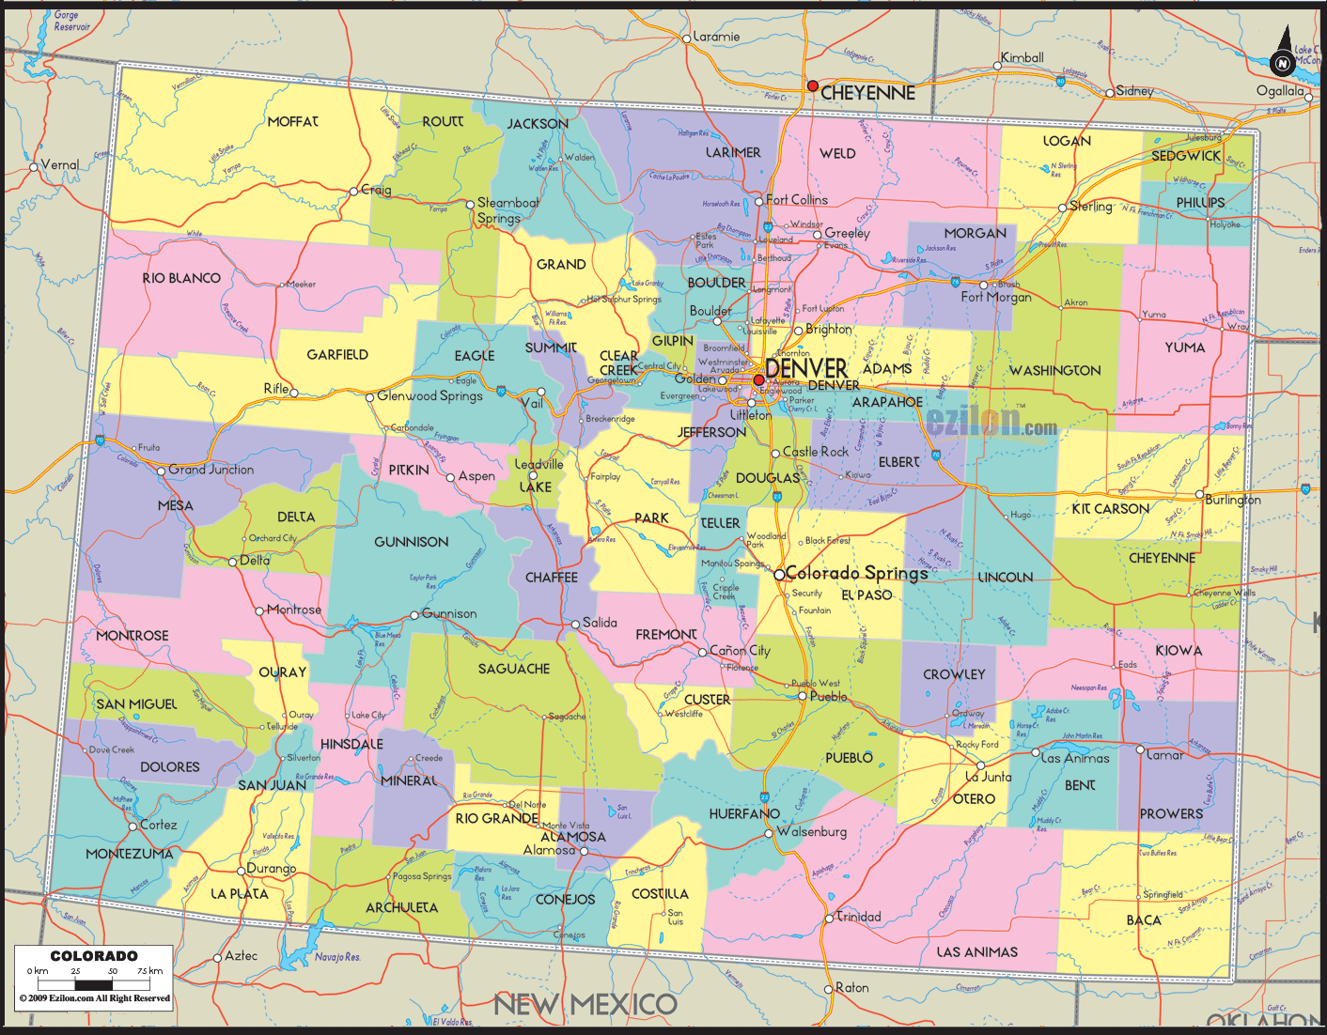
EFSLMP Colorado Objectives
Increase the number of youth/young adults receiving transition services by at least 15%, with emphasis on WIOA Pre-Employment Transition Services. Target wages in integrated work experiences at or above the state minimum wage.
Increase the number of employers hiring people with disabilities by at least 10%.

Slide 6
EFLSMP Transition Milestones
1.1. SWOT (Strength, Weakness, Opportunity, Threat) Analysis of current transition efforts, including School to Work Alliance Program (SWAP)
1.2. Develop any policy or program implementation components related to the SWOT analysis.
1.3. Implement SWOT improvements leading to sustained competitive integrated employment options for youth with disabilities.

Slide 7
EFLSMP Vision Quest Activities and Deliverables
Twice monthly conference calls with CO team
Technical assistance support
Quarterly calls with other states focused on workforce development
Policy document(s) created and presented to state leadership by end of September 2016

